Slide 1
Java Spring Boot –
From Greenfield to REST controller in 30 minutes.
Notes:
Talk about:
The plan to move to a multi-module project
Parent pom – SLN file (solution file)
Reiterate – Java annotations are a big part of Spring
More annotation-heavy than C#
Go through files and compare
Response Entity -> IActionResult
Routing = the same
Validation -> attribute
Request variable, path variables
Naming convention of the Interface/ServiceImpl
Mocking – when we add the persistence layer

Slide 2
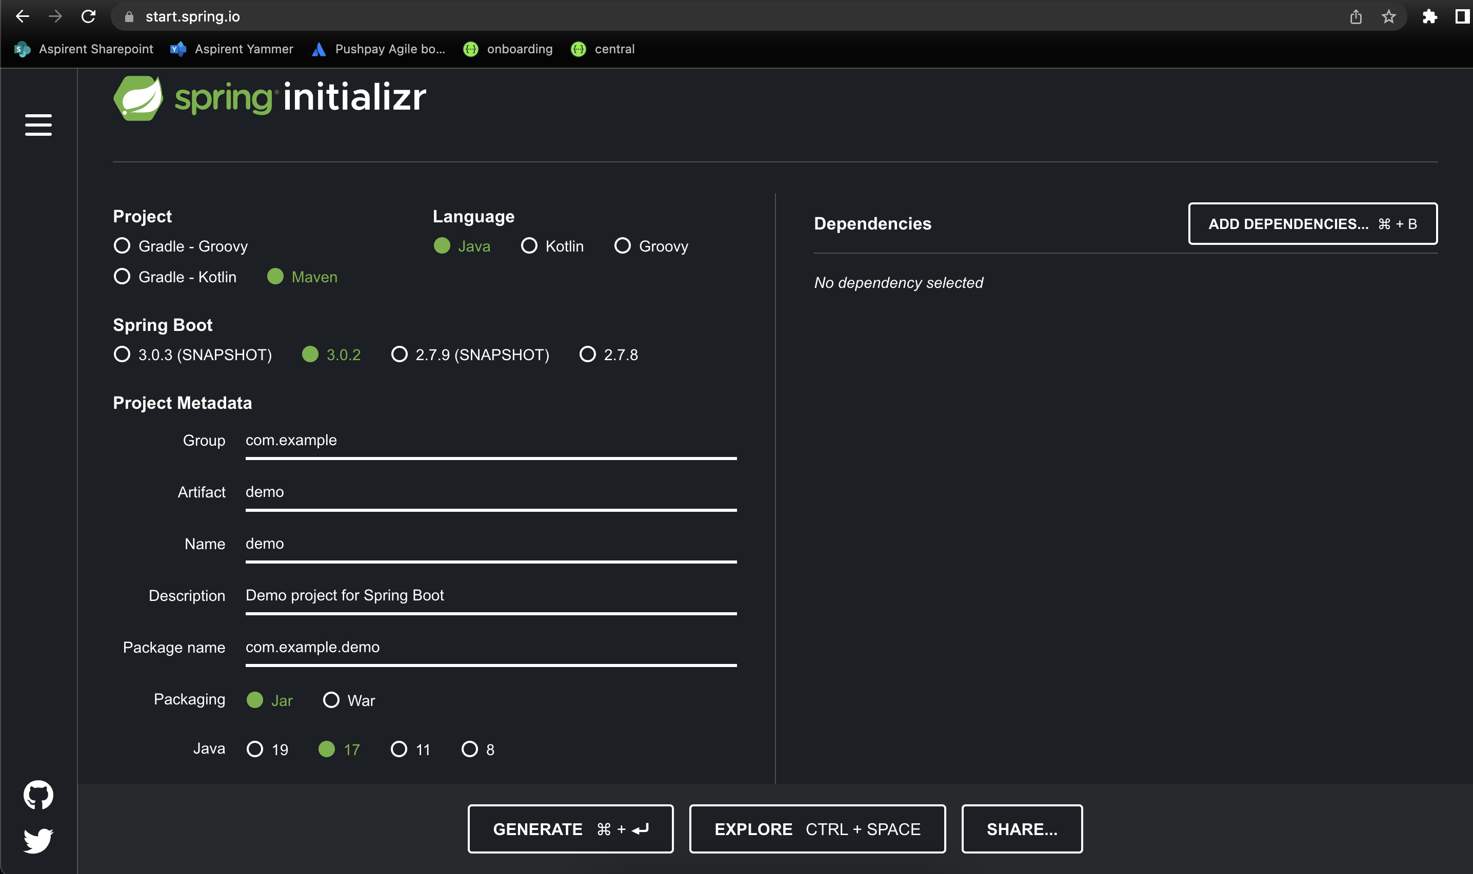
How Do I get started with Spring Boot?
Spring provides a website to create and download preconfigured and working empty projects to get you started quickly!
https://start.spring.io/

Slide 3
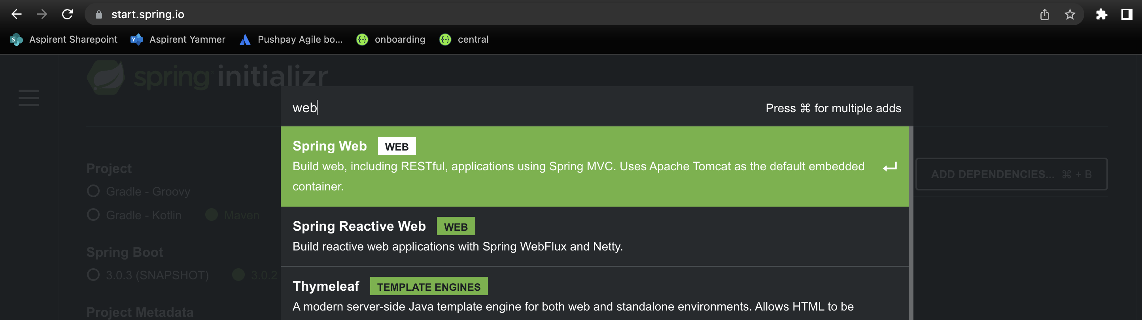
Creating an empty REST controller project
As simple as going to start.spring.io and searching for the “web” dependency!

Slide 4
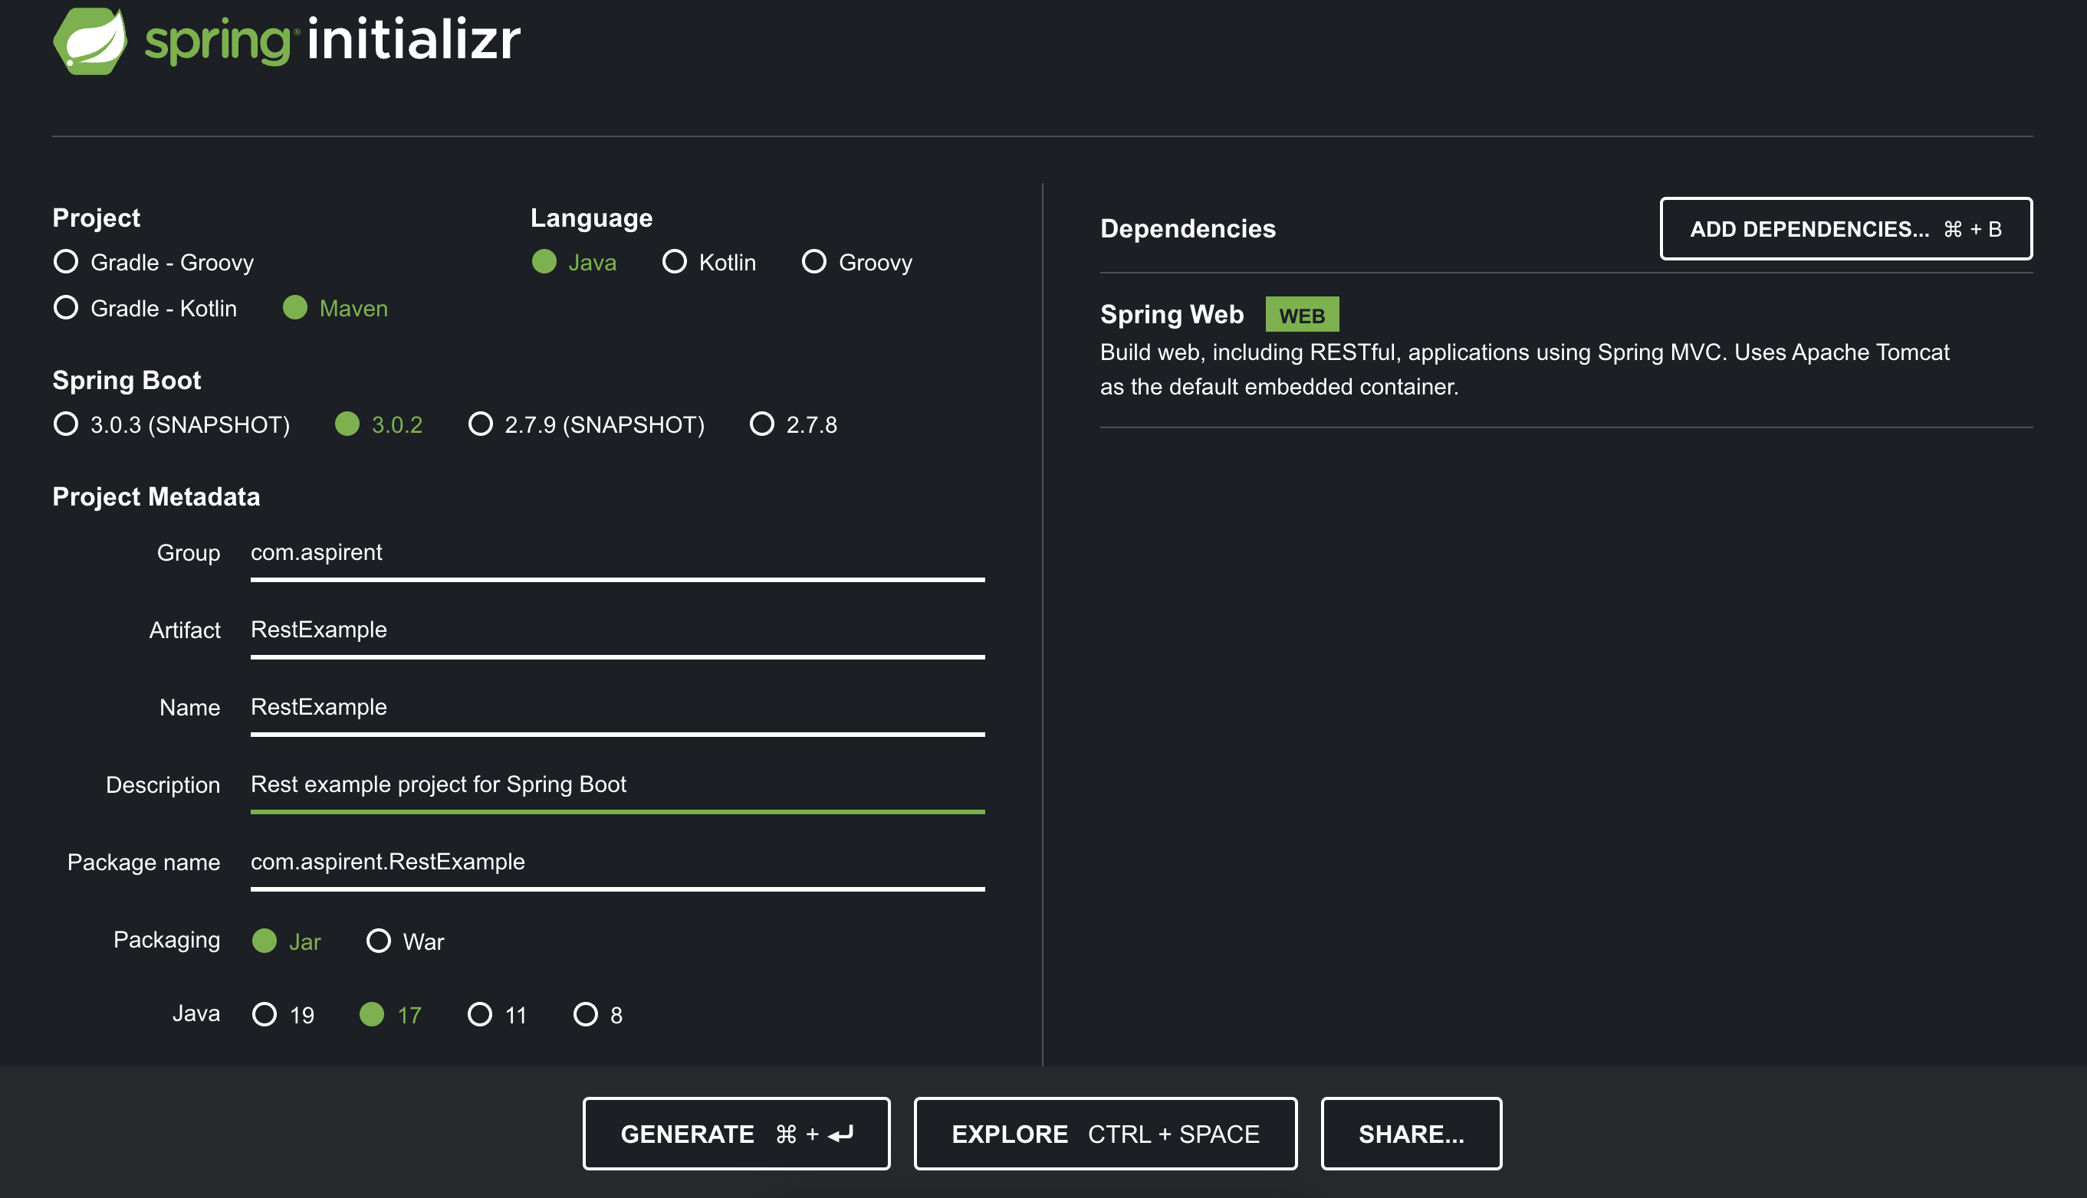
Generating an empty REST controller project

Slide 5
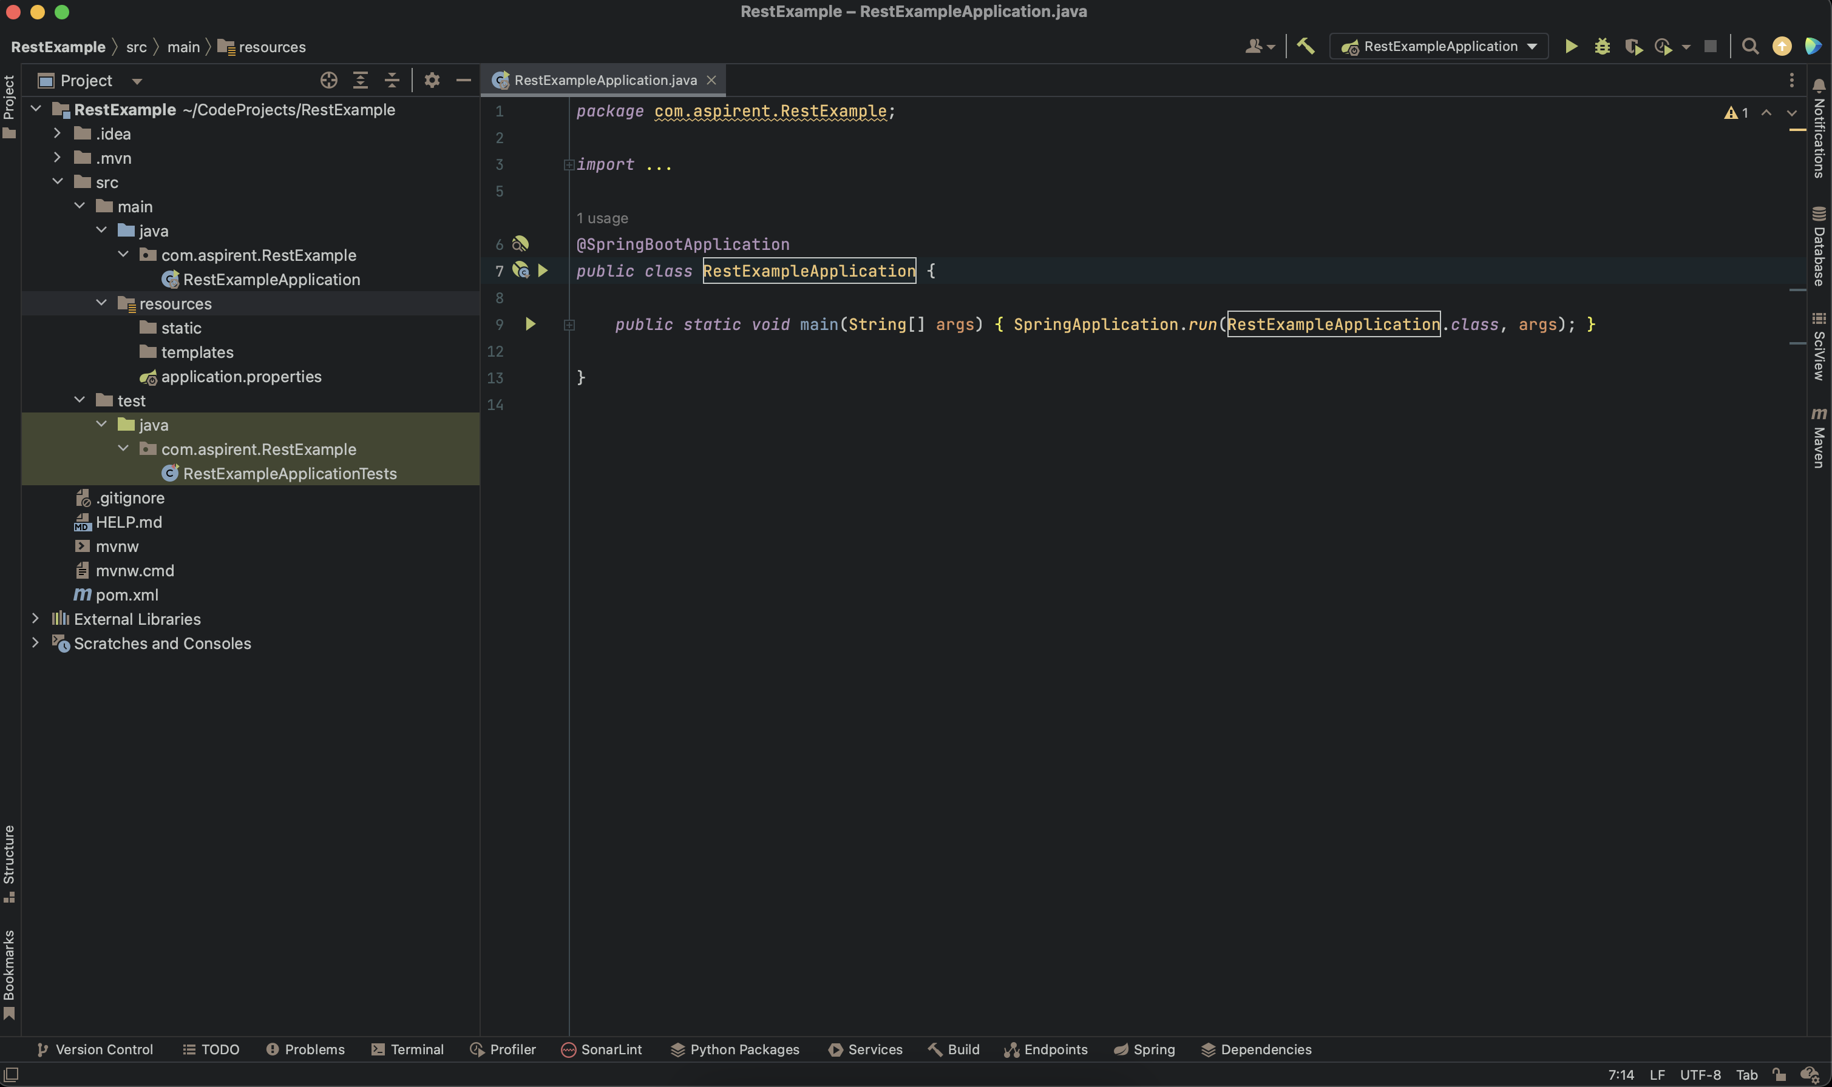
What does the newly downloaded zip file include?

Slide 6
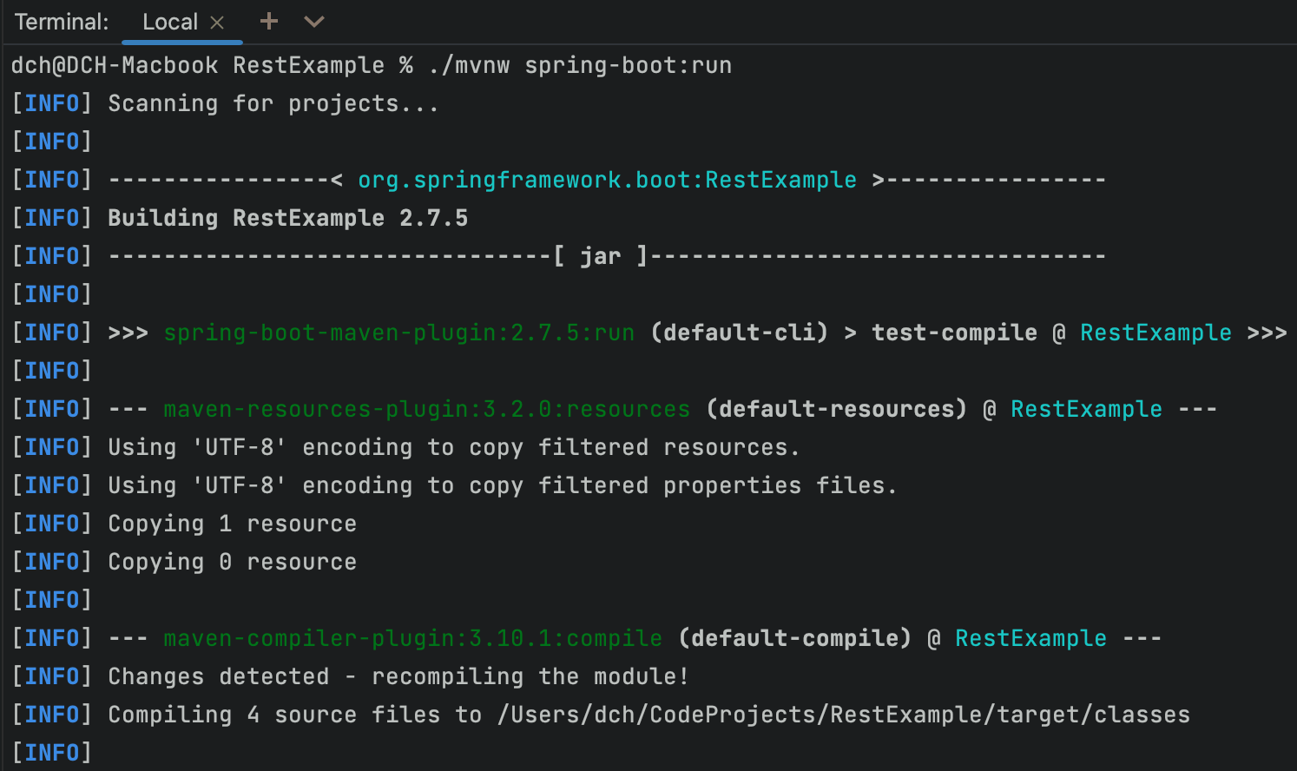
Since we’re using Maven we’ll run the app through the the maven wrapper:
How to run the newly generated project:
./mvnw spring-boot:run

Slide 7
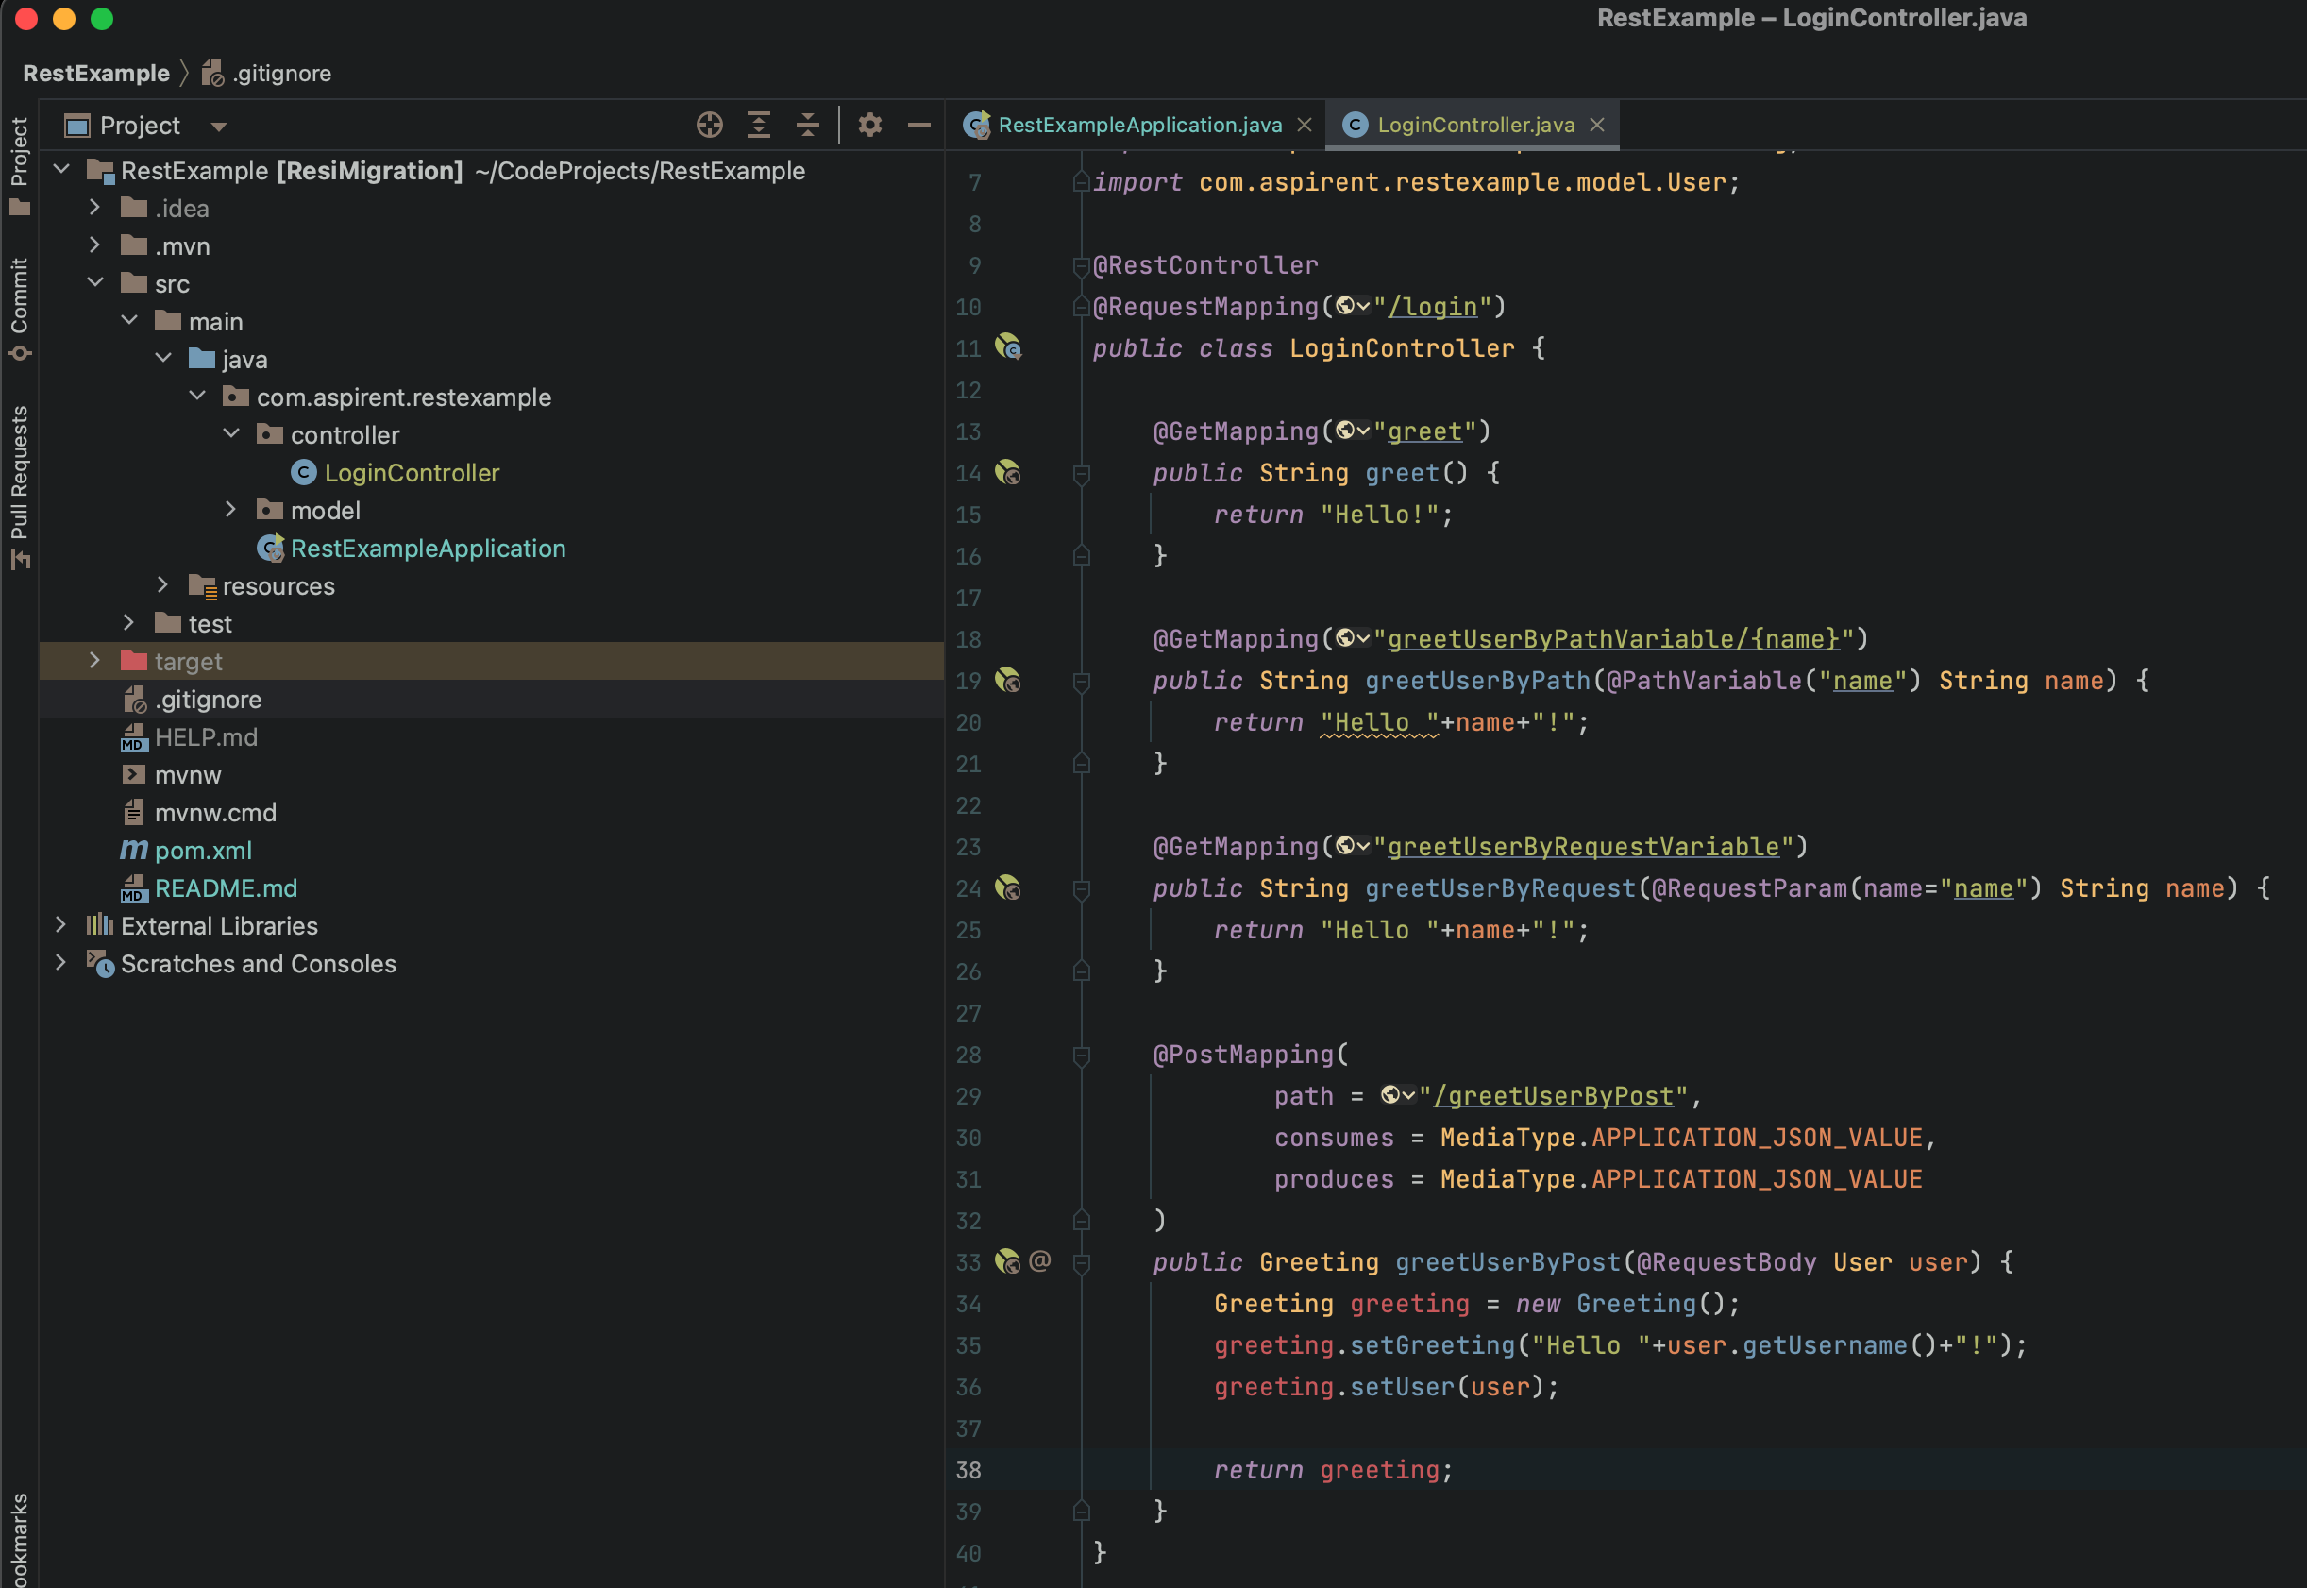
Create a basic Controller class:

Slide 8
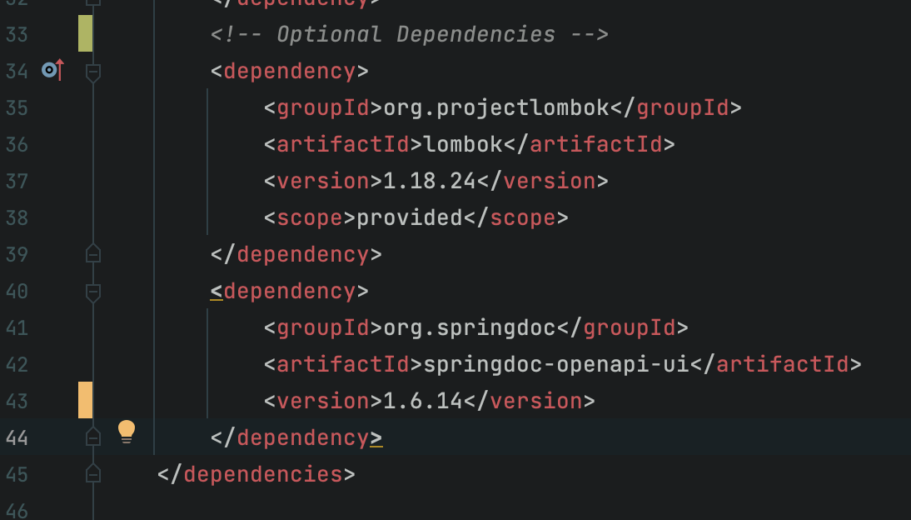
Since we’re using Maven we add the two libraries to our pom.xml
Let’s add Swagger and Lombak:

Slide 9
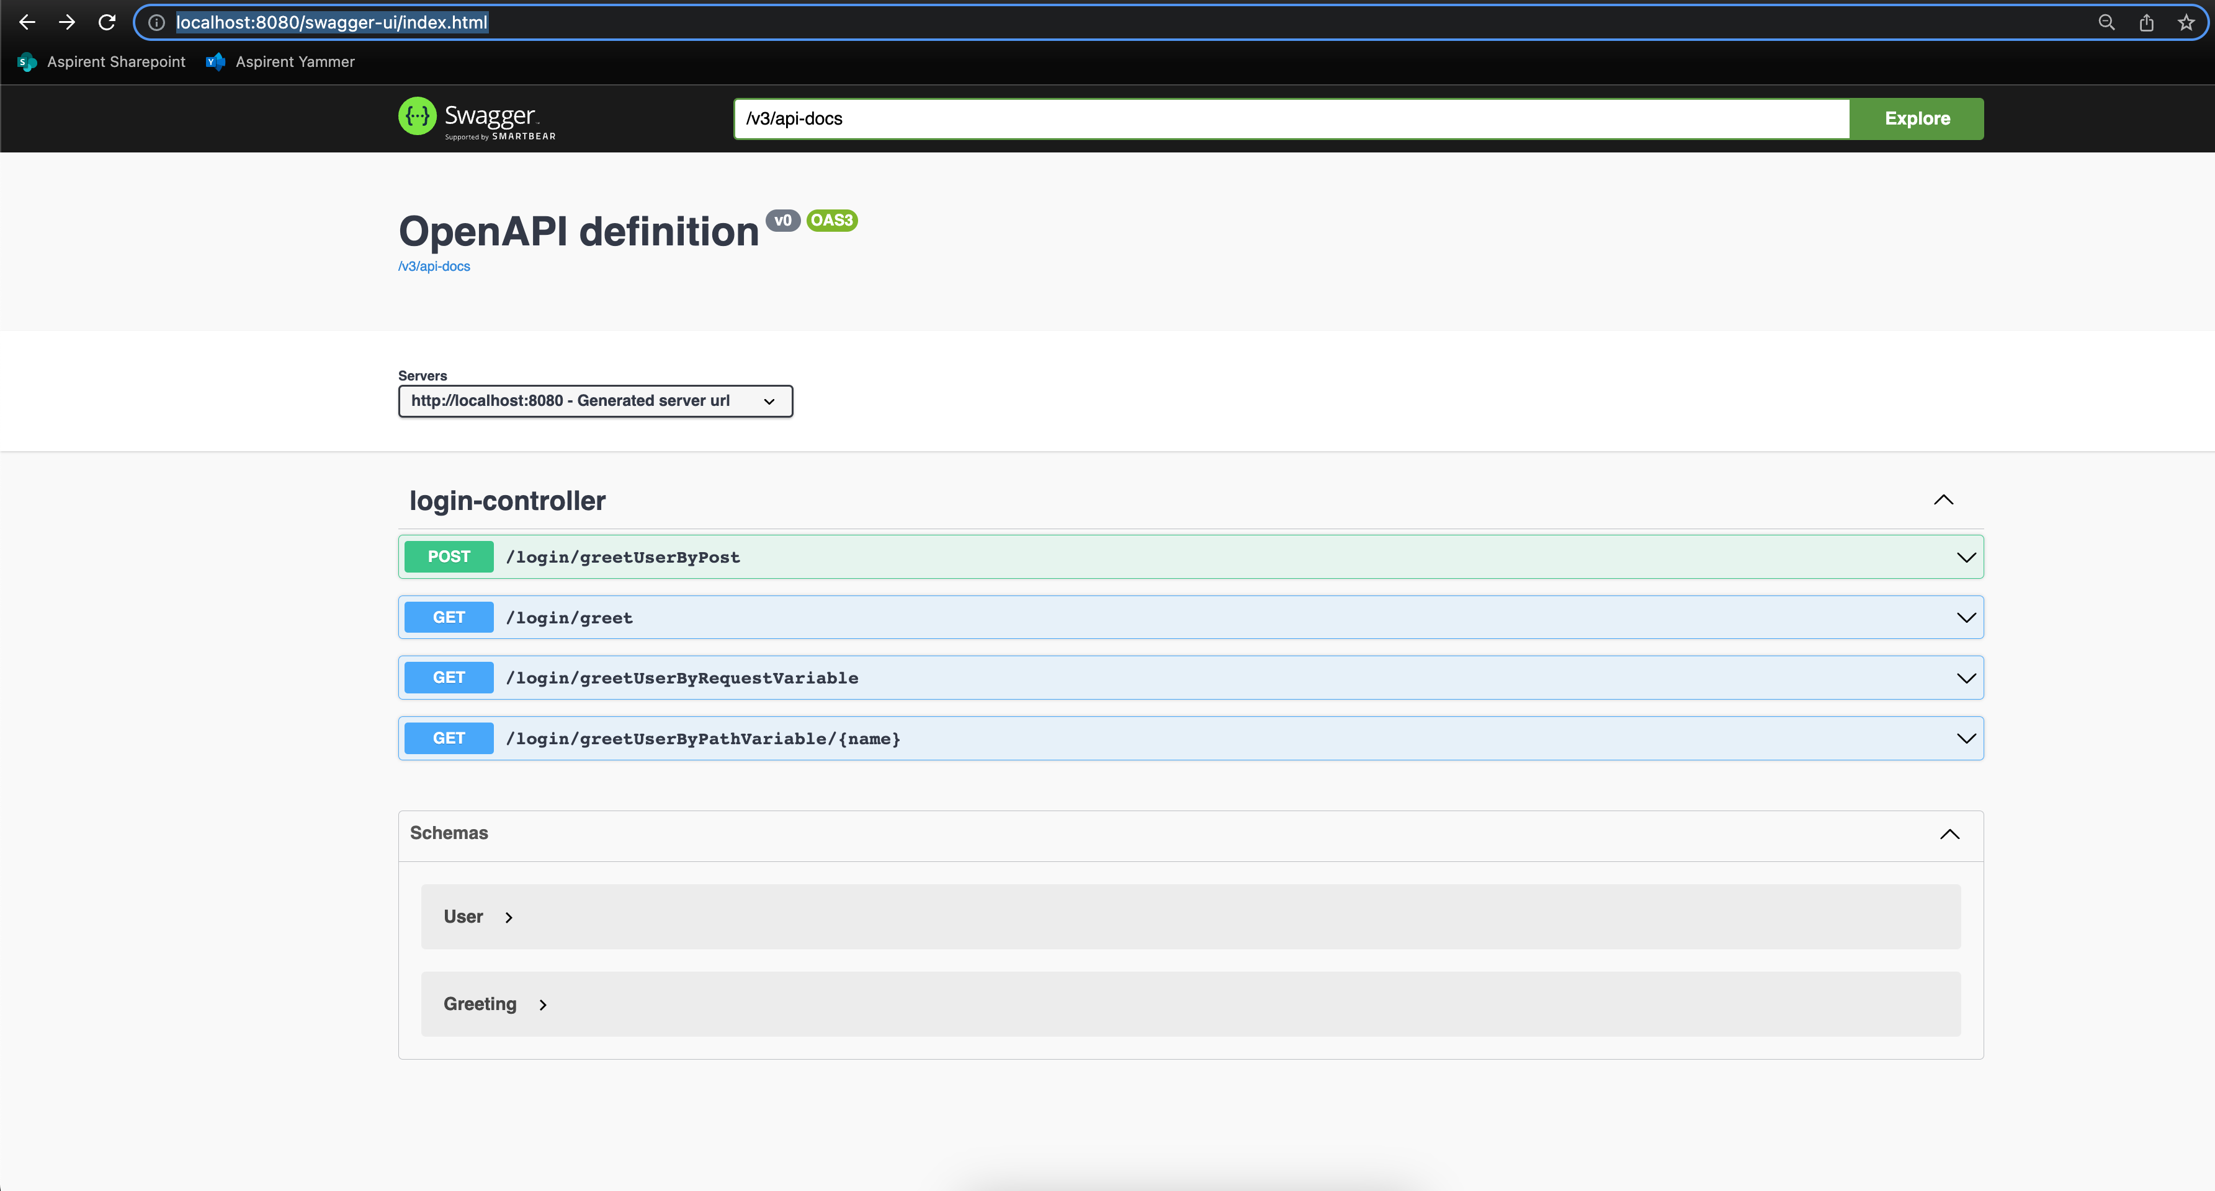
Navigate to: http://localhost:8080/swagger-ui/index.html
What does Swagger give us:

Slide 10
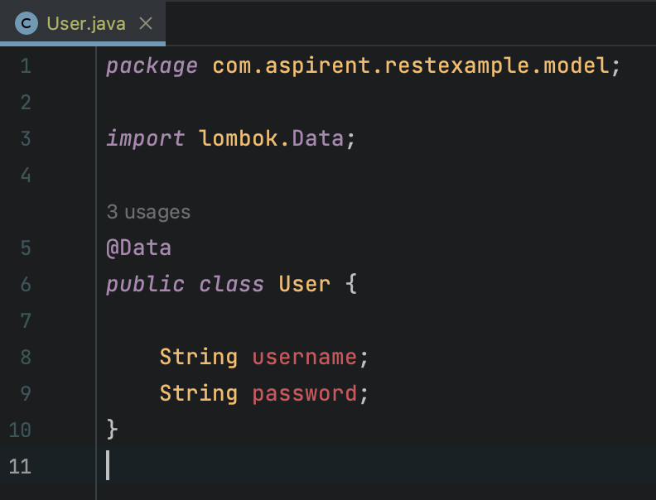
Automatic getter and setter creation:
What does Lombak give us:

Slide 11
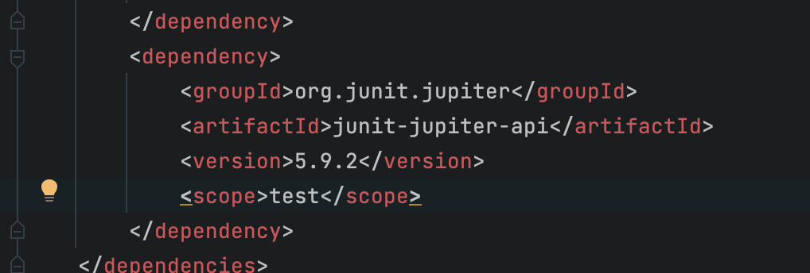
Add the Junit Dependency :
Adding Unit Testing

Slide 12
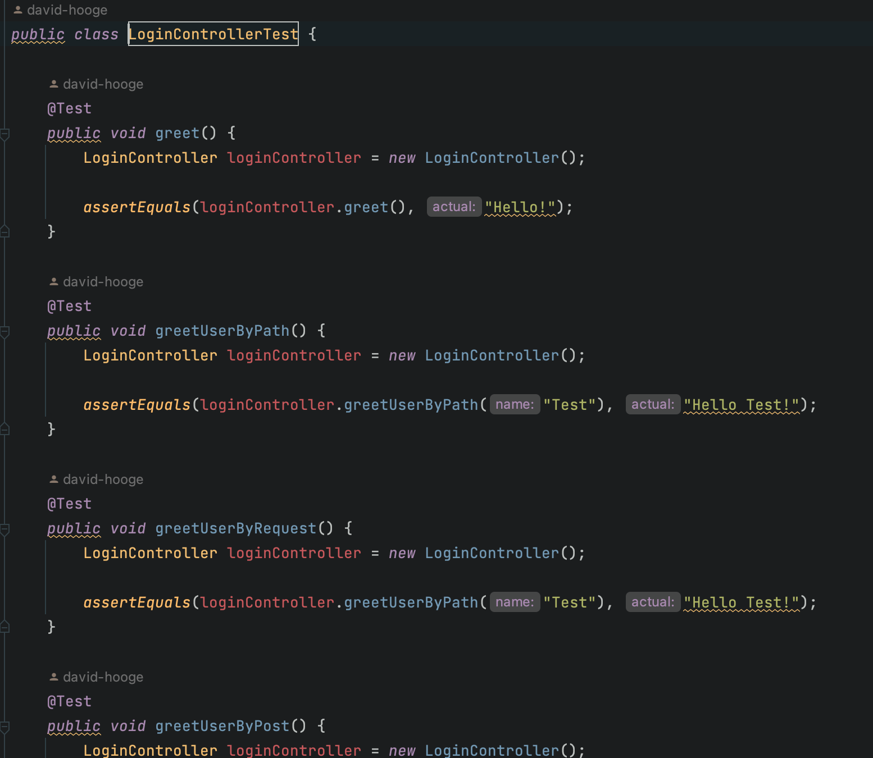
Add testing code:
Adding Unit Testing

